Slide 1

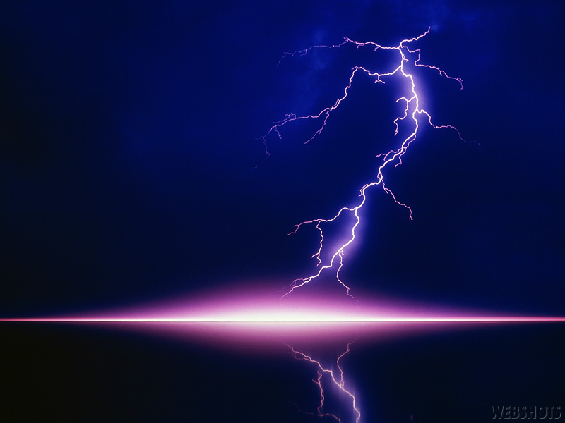
Electrical System
Conductors, Insulators, and Semi-conductors
What are they?
Hemet High Automotive

Slide 2
Learning Objective
Student will be able to describe
and differentiate between:
Conductors
Insulators
Semi-conductors

Slide 3
Conductors
A conductor is a material which contains movable electrical charges. In metallic conductors, such as copper, steel, or aluminum, the movable charged particles are electrons.
The most commonly used electrical conductors in automobiles are copper, aluminum, and steel (or iron).
Automotive electrical systems typically use insulated metal wire and the vehicle’s steel body as conductors.
Other metallic conductors include...

Slide 4
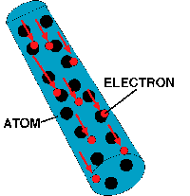
Conductors (continued)
Electrons in wire always flow over the surface of the wire, not through the middle.

Slide 5
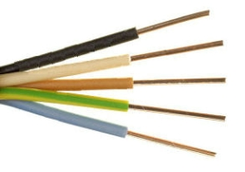
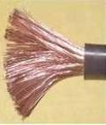
Conductors (continued)
Solid core wire
Braided/stranded wire
Braided wiring has more surface area and withstands movement better than solid core wire.
Which type of wire would you expect to find in an automobile?

Slide 6
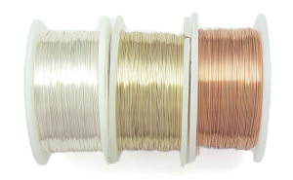
Conductors (continued)
Which type of wire would you expect
to conduct the best?
Silver, Gold, or Copper?

Slide 7
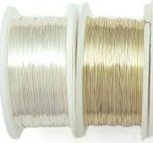
Conductors (continued)
Which two types of wire would conduct the best?
Solid Silver Wire, Solid Gold Wire,
Braided Silver Wire, Braided Gold Wire,
Braided Gold Plated Copper Wire
Which would be most economical?
(Discussion)

Slide 8
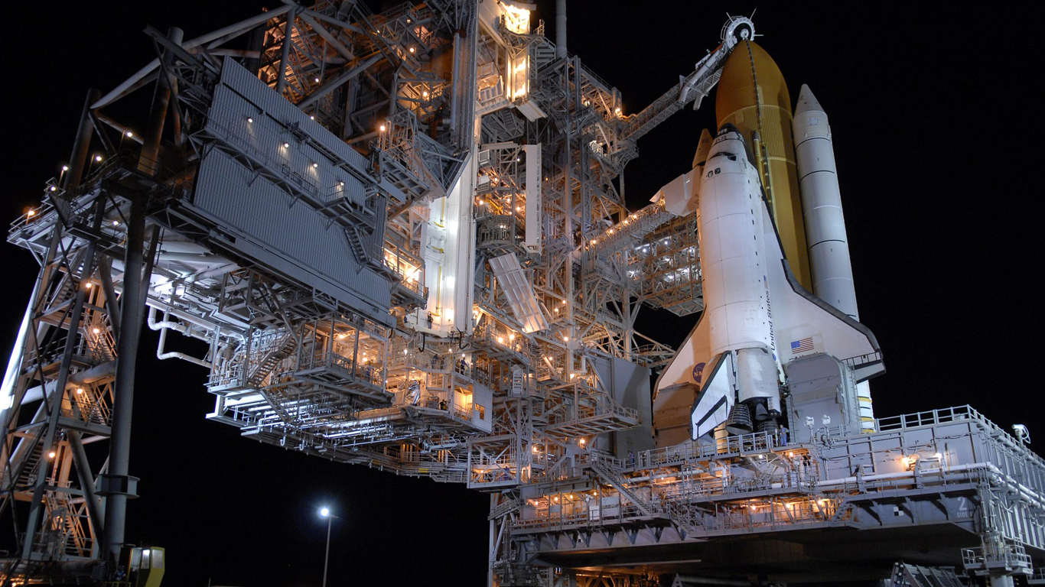
Conductors (continued)
Which type of wire would you expect NASA to use on critical systems in the space shuttle?

Slide 9
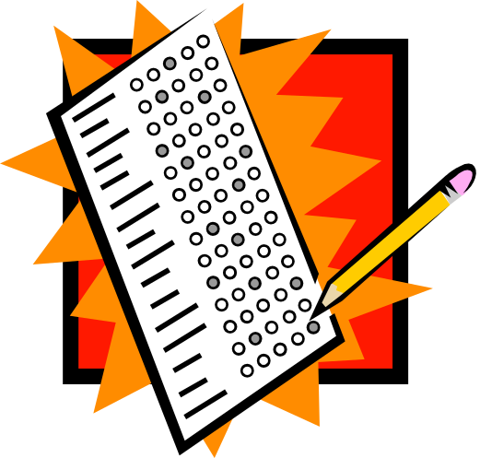
Conductors (continued)
Checking for understanding
Now a Quiz!

Slide 10
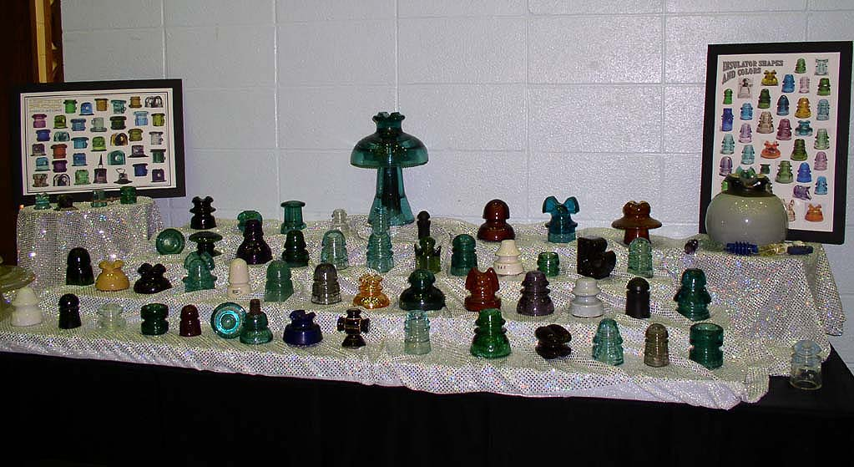
Insulators

Slide 11
Insulators (defined)
An insulator, also called a dielectric, is a material that resists the flow of electric current. An insulating material has atoms with tightly bonded valence electrons. These materials are used in parts of electrical equipment, also called insulators or insulation, intended to support or separate electrical conductors without passing current through themselves.

Slide 12
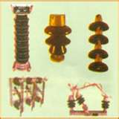
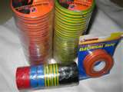
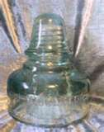
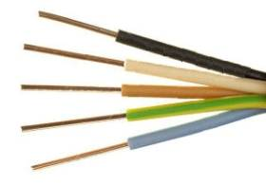
Insulators (materials)
Some materials such as glass, paper or Teflon are very good electrical insulators. A much larger class of materials, for example rubber-like polymers and most plastics are still "good enough" to insulate electrical wiring and cables even though they may have lower bulk resistivity. These materials can serve as practical and safe insulators for low to moderate voltages (hundreds, or even thousands, of volts).

Slide 13
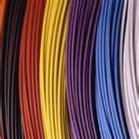

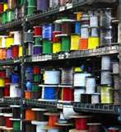
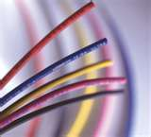
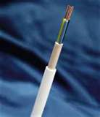
Insulators (wiring)

Slide 14
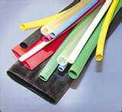
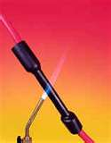
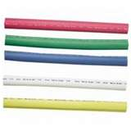
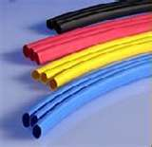
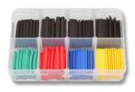
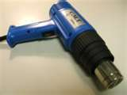
Insulators (heat shrink tubing)

Slide 15
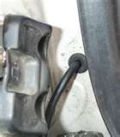
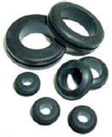
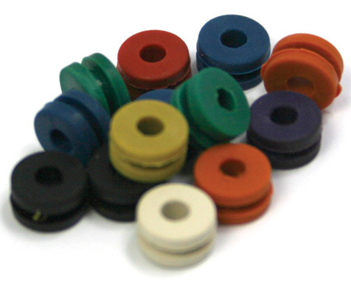
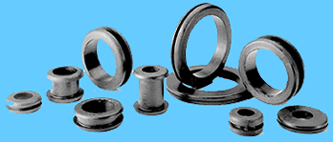
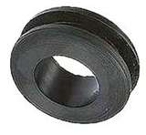
Insulators (grommets)

Slide 16
Insulators (quiz)
Checking for understanding
Now a Quiz!

Slide 17
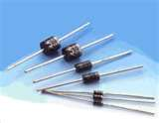
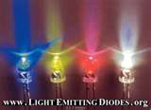
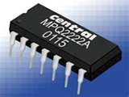
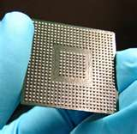
Semi-Conductors
A semiconductor is a material that has an electrical conductivity between that of a conductor and an insulator, that is, generally in the range 10³ Siemens/cm to 10⁻⁸ S/cm.

Slide 18
Semi-Conductors (Devices)
Devices made from semiconductor materials are the foundation of modern electronics, including radio, computers, telephones, and many other devices. Semiconductor devices include the various types of transistors, solar cells, many kinds of diodes including the light-emitting diode, the silicon controlled rectifier, and digital and analog integrated circuits. Solar photovoltaic panels are large semiconductor devices that directly convert light energy into electrical energy.

Slide 19
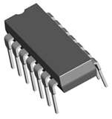
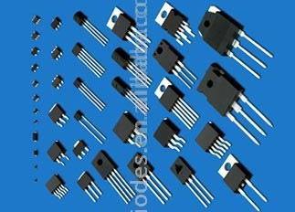
Semi-Conductors (Devices)
Diodes
Light-Emitting Diodes
Integrated Circuit
Computer CPU
Transistors

Slide 20
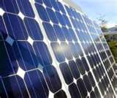

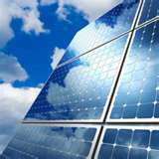
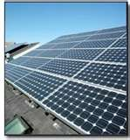
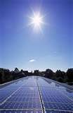
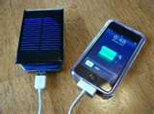
Semi-Conductors (Solar Cells)

Slide 21
Semi-Conductors
Learning about Semi-Conductors would be a class or course of study in itself.
For this course, an awareness level of understanding what Semi-Conductors are and how they are used in automotive circuits will be covered in the schematic symbols power-point lesson.

Slide 22
Semi-Conductors (quiz)
Checking for understanding
Under Construction!

